Slide 1
Data Warehouse

Slide 2
What is a Data Warehouse?
Definition: A data warehouse is a centralized repository designed to store, integrate, and analyze large volumes of data from multiple sources.
Purpose: Facilitates decision-making by providing a unified view of historical and current data.
Key Characteristics:
Subject-oriented
Non-volatile
Time-variant
Integrated

Slide 3
Why do we need data warehouses?
Challenges Without a Data Warehouse:
Data silos and lack of integration
Inefficient reporting
Limited historical data analysis
Benefits:
Improved decision-making
Centralized data for consistency
Efficient querying and reporting
Scalability for large datasets

Slide 4
OLAP VS OLTP

Slide 5
Online Analytical Processing (OLAP):
Focus: Analytical queries and reporting
Data: Historical and aggregated
Operations: Read-heavy, complex queries

Slide 6
Online Transaction Processing (OLTP):
Focus: Day-to-day transactional processing
Data: Current and detailed
Operations: Write-heavy, simple queries

Slide 7
Importance of data dimensionality
Dimensionality in Data Warehousing:
Enables intuitive and efficient data analysis.
Organizes data into facts (measurable quantities) and dimensions (descriptive categories).
Benefits:
Simplifies data navigation.
Enhances query performance.
Supports multi-dimensional analysis (e.g., sales by region and time).

Slide 8
Star Schema
Structure:
Central fact table surrounded by multiple dimension tables.
Advantages:
Simplified queries
Easy to understand and implement
Example:
Fact table: Sales
Dimensions: Time, Product, Region

Slide 9
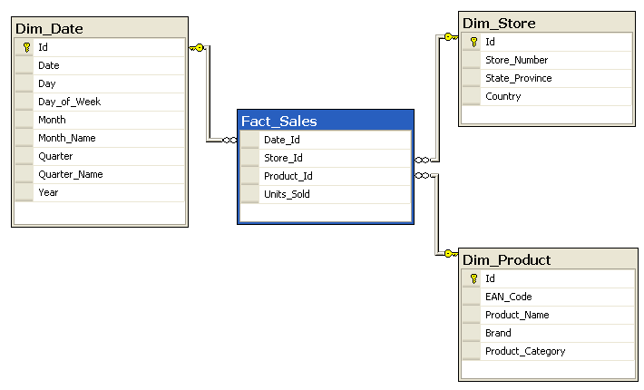

Slide 10
Snowflake Schema
Structure:
Dimension tables are further broken down into sub-dimensions.
Advantages:
Reduces data redundancy
Saves storage space
Disadvantages:
Increased query complexity
Example:
Dimension "Product" split into "Category" and "Sub-category"

Slide 11
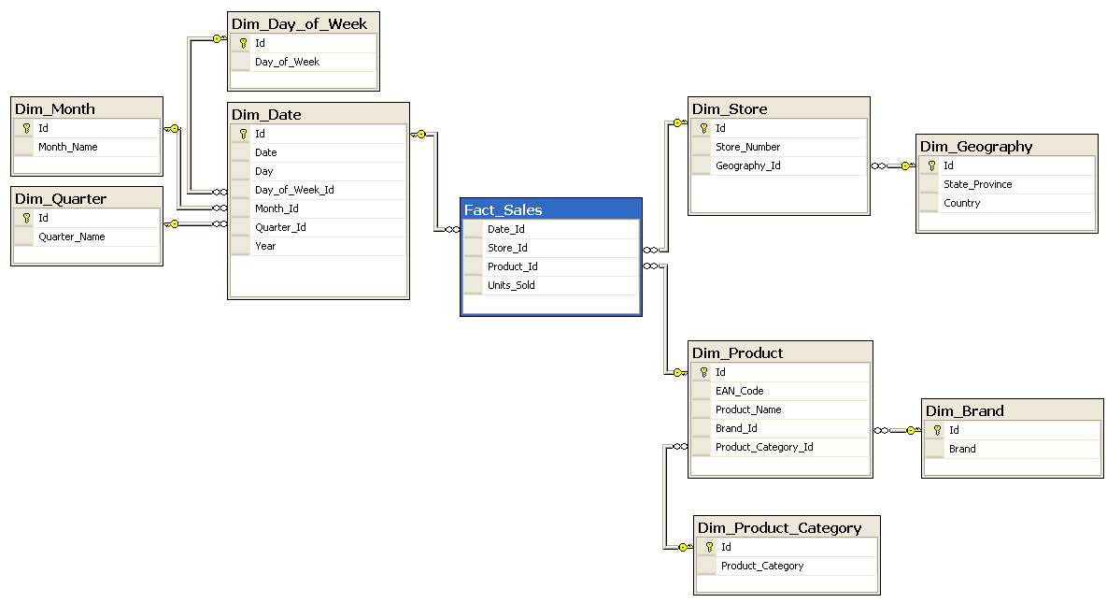

Slide 12
ETL Processes
Extract: Gather data from multiple sources.
Transform: Cleanse and format data.
Load: Insert data into the data warehouse.
Importance: Ensures data quality, consistency, and readiness for analysis.

Slide 13
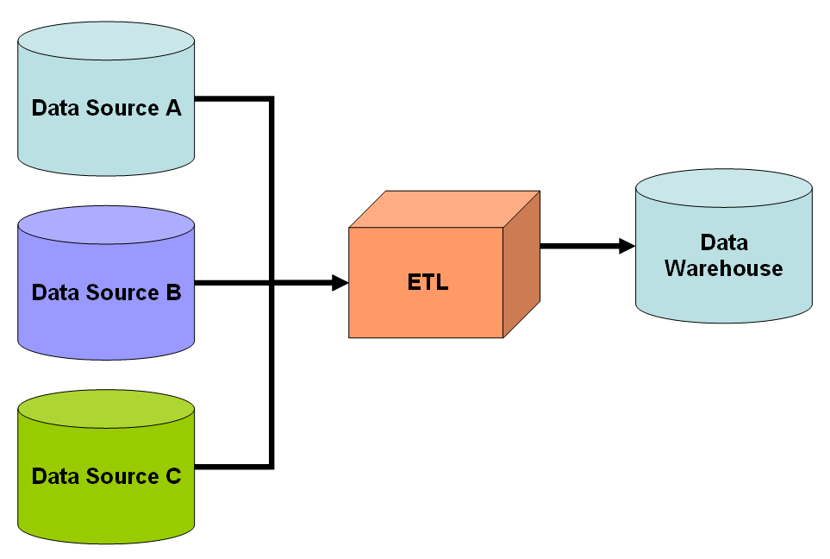

Slide 14
Tooling
Data Warehouse Platforms:
Amazon Redshift
Google BigQuery
Snowflake
Microsoft Azure Synapse
ETL Tools:
Apache NiFi
Talend
Informatica
Alteryx

